Slide 1
MY HOME INDUSTRIES PVT. LTD.
WELCOME
TO A PRESENTATION ON
By
S S MOURAY
GM-Customer Service

Slide 2
MAKE LIVING
BETTER
CEMENT REALSTATE | POWER CONSULTANCY | LOGISTICS | EDUCATION |
MEDIA & ENTERTAINMENT
|

Slide 3
MY HOME GROUP- AN OVERVIEW
My Home Group is one of the fastest growing business conglomerate with its HO at Hyderabad
It is established by ‘pride of the nation” award winner, visionary entrepreneur, Dr. J.Rameshwar Rao.
Dr. J. Rameshwar Rao,
Group Chairman

Slide 4
OUR
BUSINESSES
POWER CONSULTANCY
LOGISTICS
CEMENT
EDUCATION
REAL ESTATE
MEDIA & ENTERTAINMENT
4

Slide 5
MY HOME
CONSTRUCTIONS
Highlights
Over the last two decades, My Home Constructions has firmly
established as one of the most successful developers of real
21
26
estate in Telangana by imprinting its indelible mark across all
Completed Residential and Commercial projects
asset classes & building Happy Homes. Today, My Home
Constructions has become a name that is synonymous with
Million sft of total space completed
Quality & Trust; and close-knit communities who benefit from
quality living.
The group has redefined the landscape in Telangana across
11
10
Million sft is under development
various verticals including Residential & Commercial. A quick
glance at the numbers spans over 26 million sft of developed
Million sft under construction & planning
area, 11 million sft of on-going projects & over 10 million sft under
Over
planning.
5000+
The residential projects include apartments, gated communities,
Workforce
luxury housing & premium villas.
The commercial projects include malls, office spaces, premium &
10,000+
Happy Residents
first of its kind work hub's in Telangana.

Slide 6
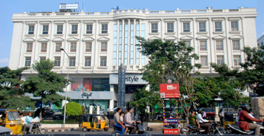
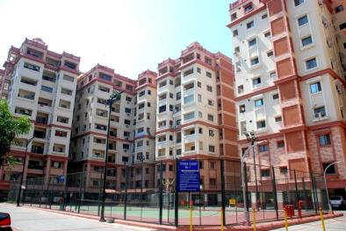
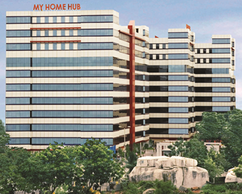
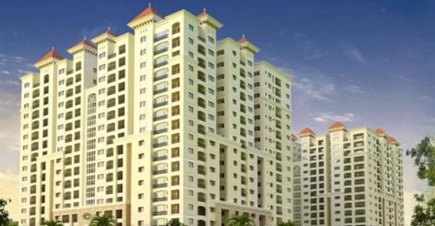
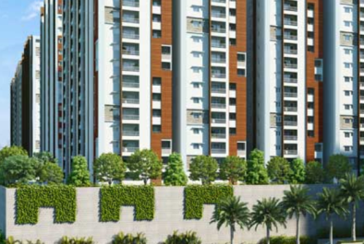
LANDMARKS PROJECTS BUILT WITH MAHA CEMENT
LIFE STYLE BUILDING
MY HOME NAVADWEEPA
MY HOME ABHRA
MY HOME VIHANGA

Slide 7
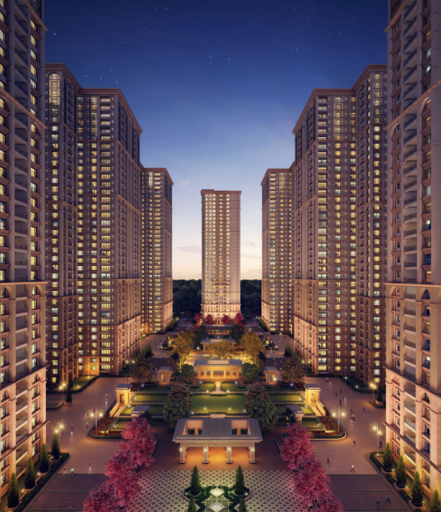
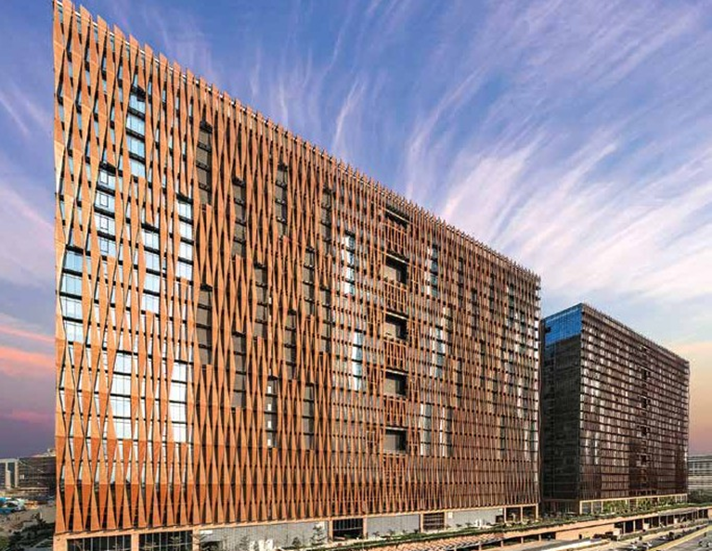
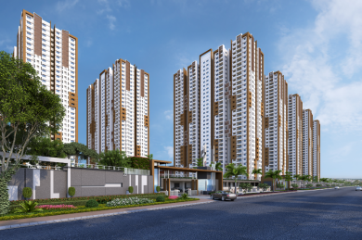
LANDMARK PROJECTS BEING BUILT WITH MAHA CEMENT
MY HOME TWITJA
MY HOME BHOOJA
36 Floors High Rise Ulra Luxury Apts
Made of 100% blended cement
SKY VIEW
MY HOME AVATAR

Slide 8
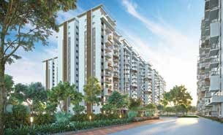
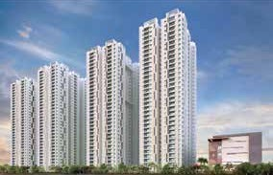
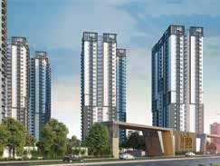
Our Legacy
MY HOME CONSTRUCTIONS - RESIDENTIAL
UNDER CONSTRUCTION
4 BHK Luxury Villas at Tellapur
2, 2.5 & 3 BHK Luxury Apartments at Kondapur
3 BHK Luxury Apartments at Kokapet
2, 2.5 & 3BHK
Premium Homes at Tellapur

Slide 9
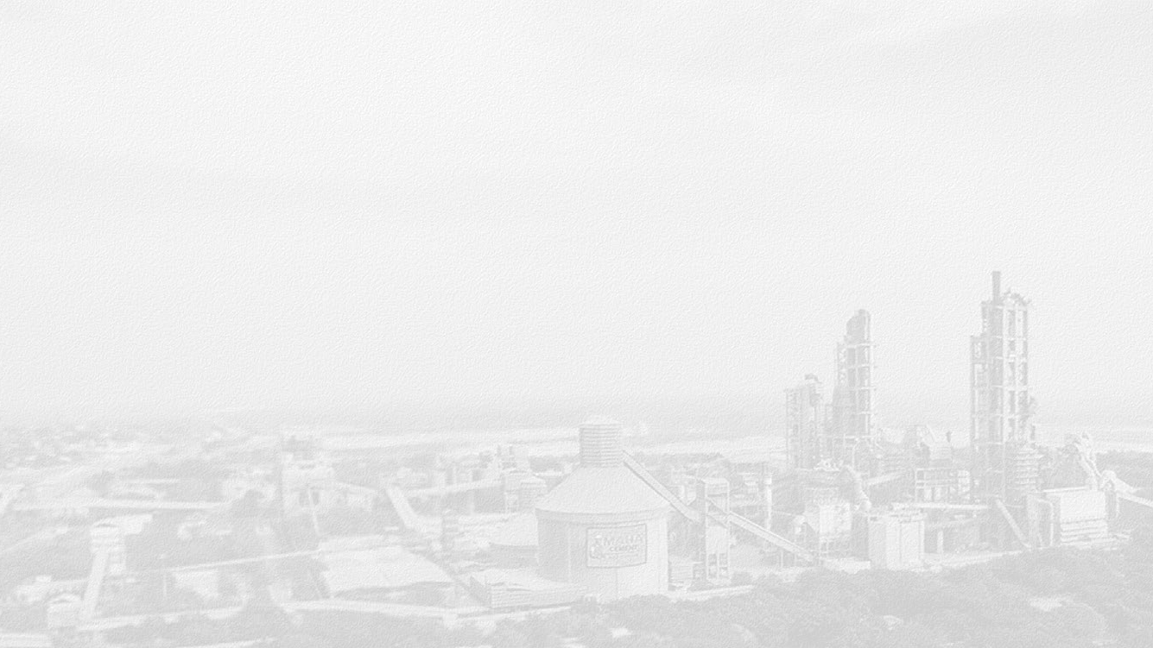
MAHA CEMENT
Highlights
Today, we are one of the largest in south India, powered by four state-of-the-art facilities across Andhra Pradesh, Telangana, and Tamil Nadu. Our marketing footprint extends us further across South and East India.
From socioeconomic development to environmental stewardship, we are making a sustainable difference to the long-term vibrancy and vitality of the people and companies we work with.
My Home continues to build on the strong foundations of our legacy. From humble villages to sprawling cities, we help ensure that the future is solid, stable, and assured.
4000+
20
170
4
10
20
Dealers
Regional ofﬁces
Depots
Plants
Million tonnes of production
Years of presence
1
18

Slide 10
MHIPL PLANTS AND INSTALLED CAPACITIES
Mellacheruvu Cement Works
3.2 Million MT per annum
Vizag Grinding Unit
2.0 Million MT per annum
Tuticorin Grinding Unit
2.0 Million MT per annum
SJCPL – Yanakandla
3.3 Million MT per annum
TOTAL 10 MILLION TONNES PER ANNUM

Slide 11
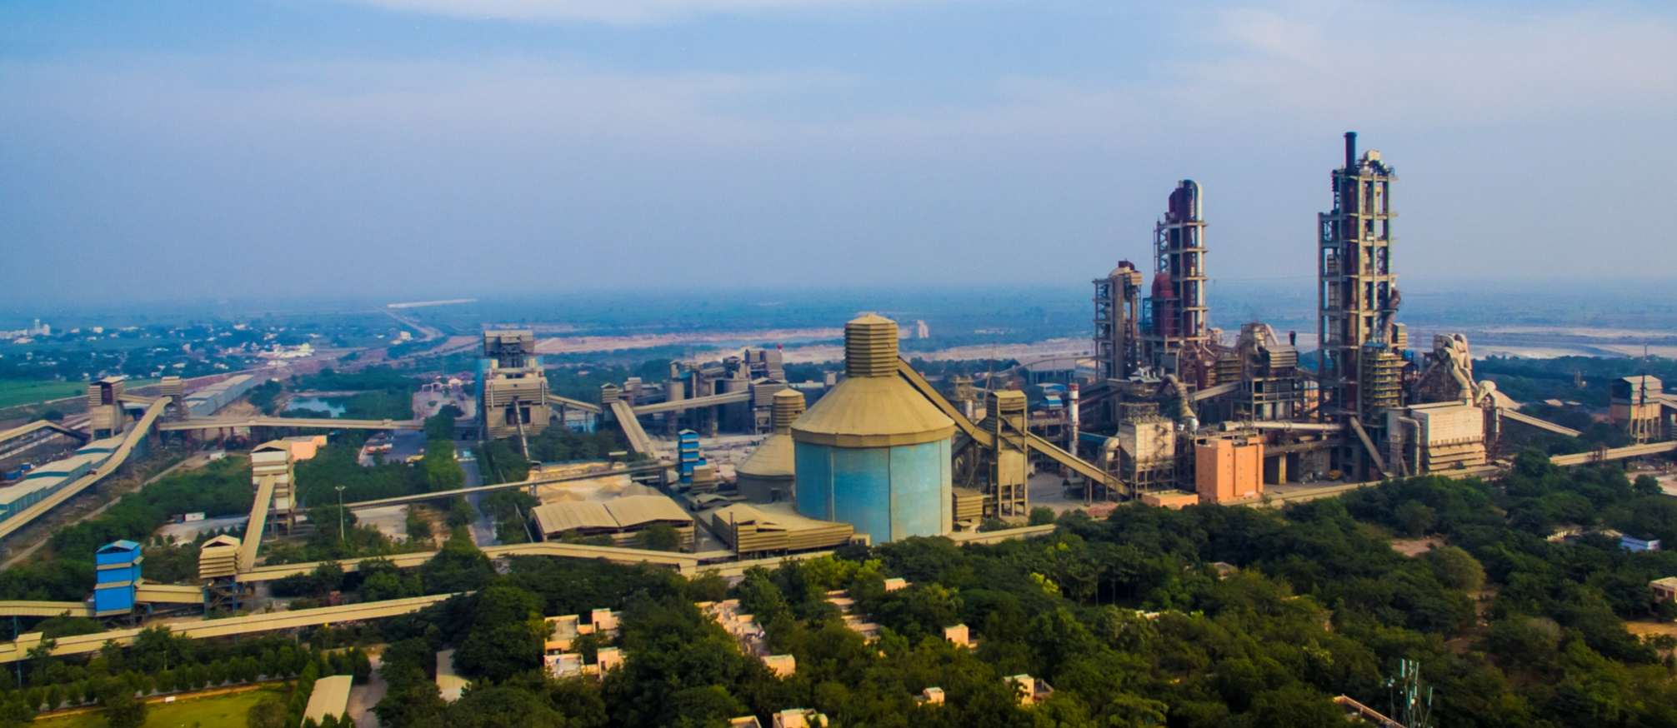
MELLACHERUVU CEMENT WORKS (MCW)
Annual capacity of 3.2 million tonnes
With three Kilns 2000 TPD, 2500 TPD and 3500 TPD
Own siding for Rake loading
Facility to utilize Alternate Fuels
Modern QA & QC lab with X-Ray and XRD

Slide 12
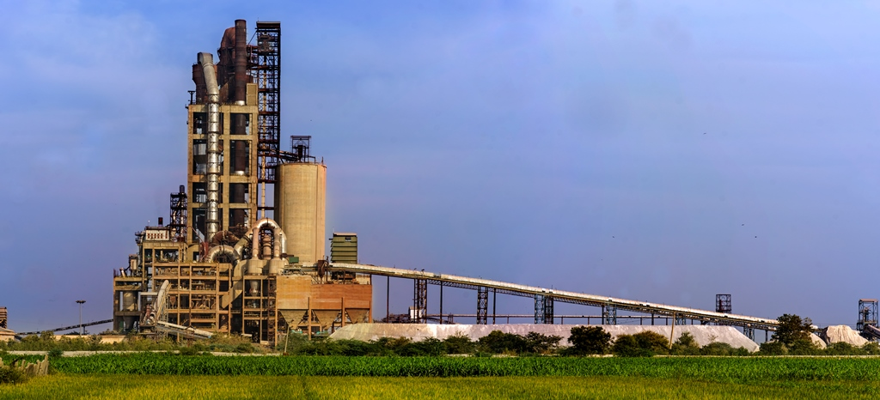
YANAKANDLA CEMENT WORKS (YCW)
Annual capacity of 3.2 million tonnes
Online cross-belt analyzer
Fully Automated Laboratory
Separate Grinding & Blending technology

Slide 13
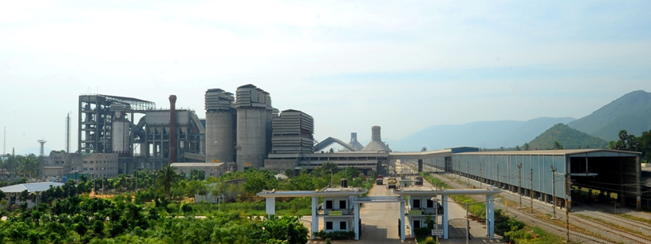
VIZAG GRINDING UNIT (VGU)
Produces 2 million tones per annum
Vertical Roller Mills for quality cement production
First Plant in India to get license to produce Composite Cement.

Slide 14
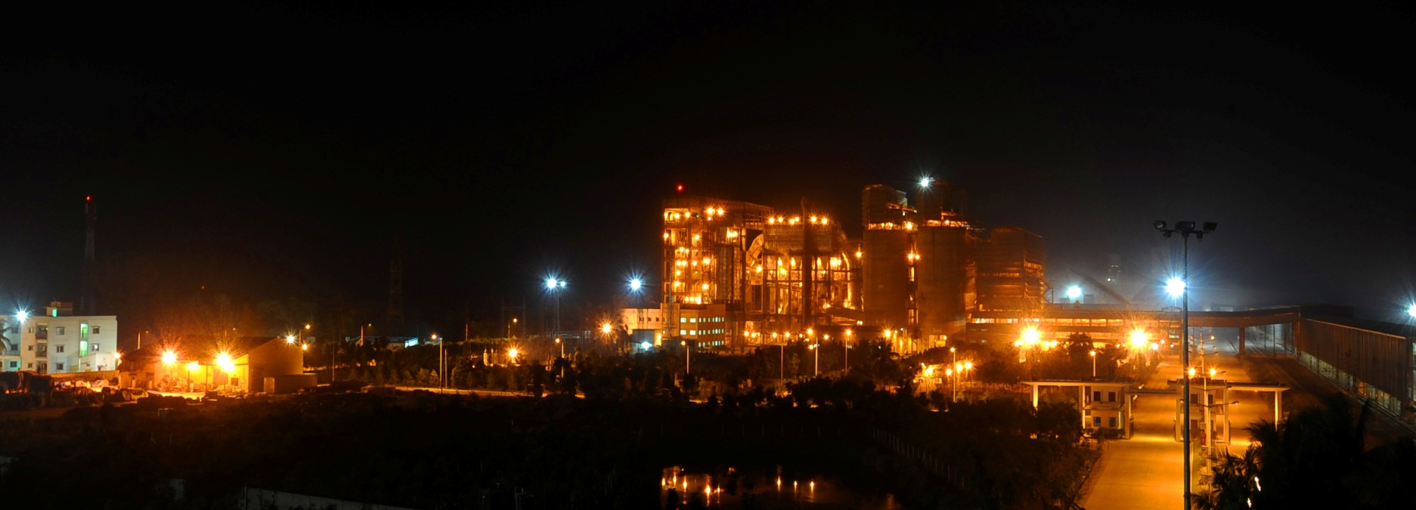
GRINDING UNIT AT THOOTHUKUDI (TGU)
Production Capacity of 1.5 million tones per annum
180 TPH Ball Mill for cement Grinding
Cement Storage Silo – 2 x 10,000 Mt

Slide 15
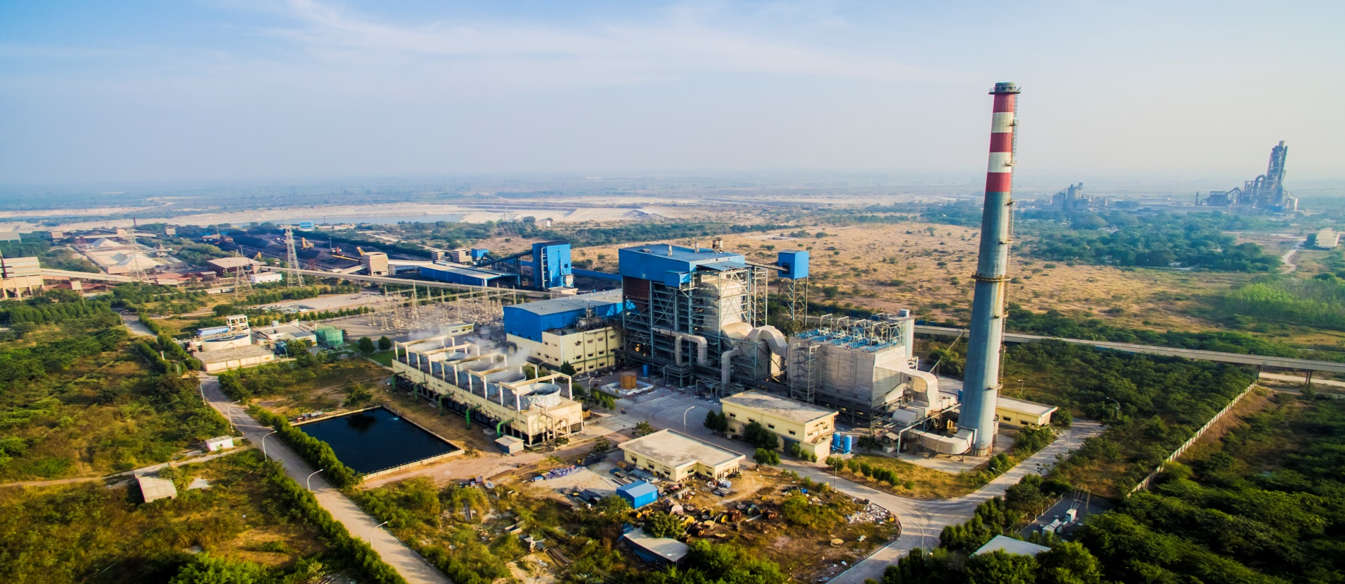
POWER PLANTS
Total Power generation of 89 MW
- Solar Power – 1.2 MW, Waste heat Recovery- 12.5 MW
Self reliant on Power - 50% used for own cement production and rest sold to the grid

Slide 16
WORLD CLASS QUALITY CONTROL SYSTEMS
All the plants are equipped with most Modern Quality Control Laboratory with X-Ray and XRD instruments.
Implemented latest version of Integrated Management System ( All Plants are ISO certified)
Special laboratories for testing cement as per Sri Lankan Standards for exports
Best Environment , Health and Safety practices – our plants won many prestigious awards for environment and safety
QUALILTY OF CEMENT- BEST IN THE INDUSTRY

Slide 17
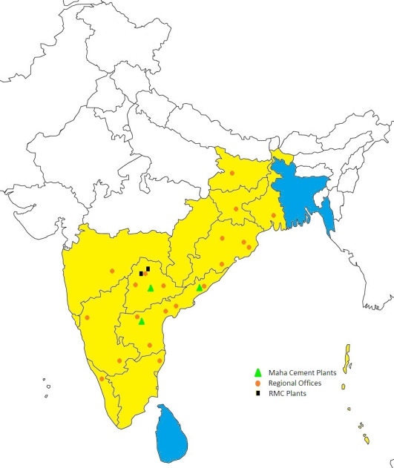
MARKET COVERAGE OF MHIPL
Supply to 12 states across South and East India in Domestic market
20 regional offices & more than 170 depots
As a part of our International business, we supply cement & clinker to Sri Lanka and Bangladesh

Slide 18
PRODUCT RANGE
Brands
Maha Cement (OPC – 43 Grade)
Maha Cement(OPC – 53 Grade)
Maha Cement – PPC
Maha Cement – PSC
Maha Cement – Composite Cement
Special blended cements:
Maha SOLID
SOLID HD+ and SOLID HD+ Super Strong
GGBS

Slide 19
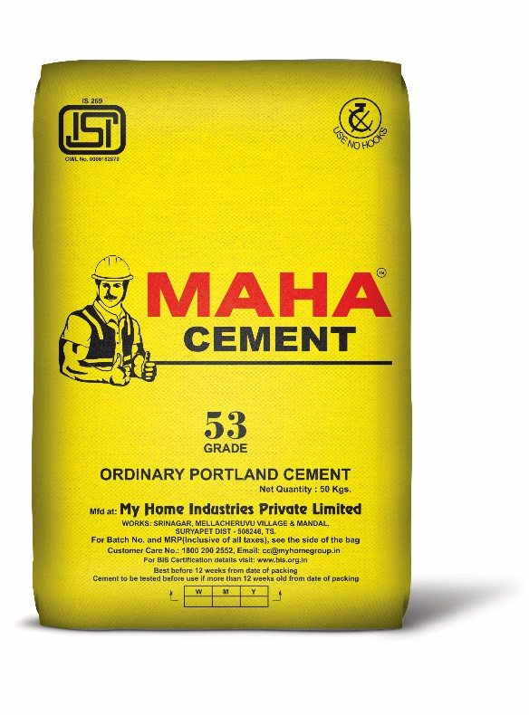
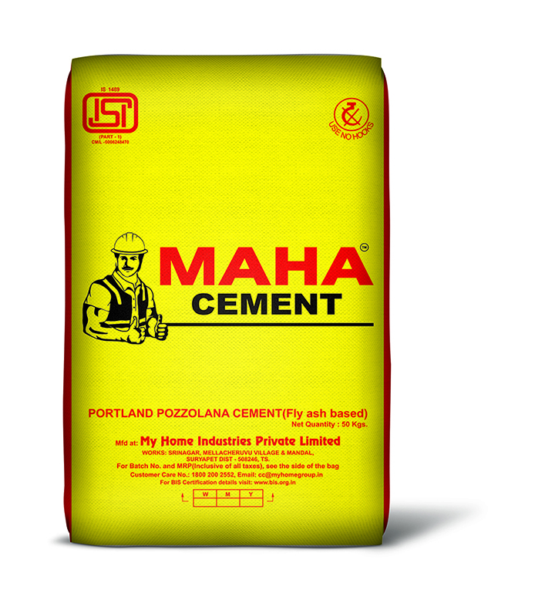
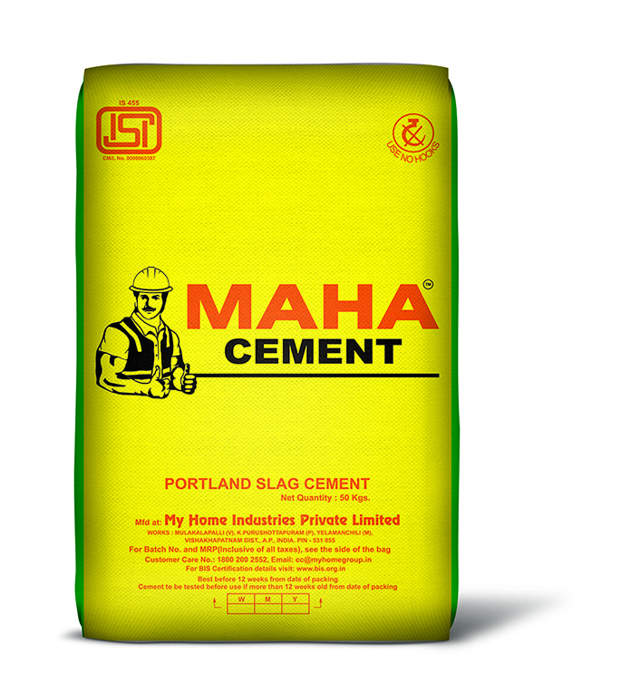
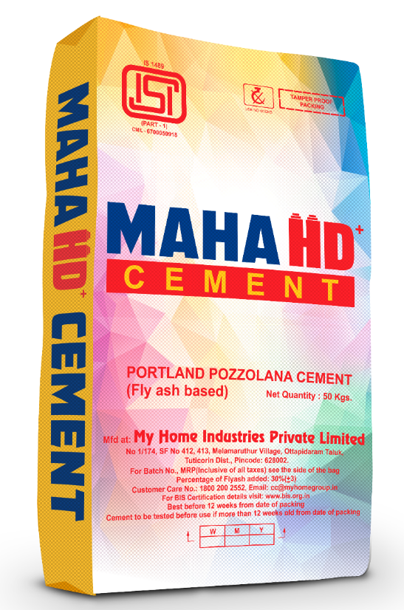
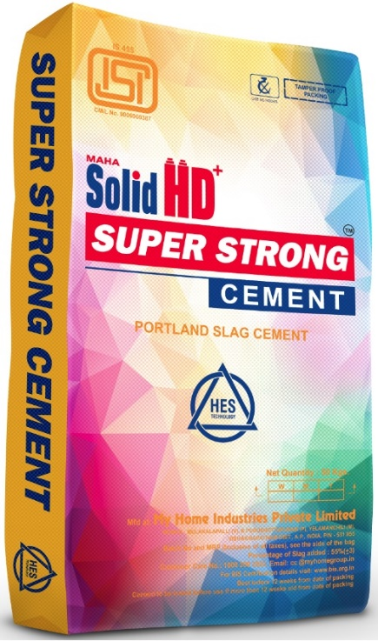
OUR BRANDS

Slide 20
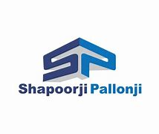
OUR CLIENTELE

Slide 21
AWARDS & RECOGNITION
MY HOME INDUSTRIES
MY HOME CONSTRUCTIONS
BEST
GOLDEN PEACOCK AWARD
FOR INNOVATIVE PRODUCT &
SERVICES FOR MAHA CEMENT
NATIONAL AWARD FOR EXCELLENCE IN
COST MANAGEMENT
BY INSTITUTE OF COST ACCOUNTANTS OF INDIA (2015)
REAL ESTATE
BEST RESIDENTIAL PROJECT AWARD
FOR
MY HOME ABHRA (2015)
BEST
CONSTRUCTION COMPANY SERVICE QUALITY AWARD
BY APS RESEARCH & MEDIA (2016)
INTEGRATED MARKETING CAMPAIGN AWARD
FOR MY HOME AVATAR
MOST TRUSTED DEVELOPER IN SOUTH INDIA
BY WORLDWIDE ACHIEVERS
SILVER AWARD
BY
SEEM NATIONAL ENERGY MANAGEMENT
CREATE AWARD
FOR
MY HOME VIHANGA BY CREDAI (2017)
CRISIL 6 RATING PROJECT
FOR
MY HOME JEWEL
MOST TRUSTED DEVELOPER IN SOUTH INDIA
BY WORLDWIDE ACHIVERS 2019
INDIA’S MOST PROMISING BRAND 2015
FOR MAHA CEMENT BY WCRC &
I-BRANDS 360
EXCELENCE IN PROJECT DELIVERY
FOR MY HOME AVATAR
2020
21

Slide 22
Awards

Slide 23
QUALITY AWARDS

Slide 24
AWARDS AND RECOGNITIONS
Golden Peacock Award for Sustainability for the year 2017 being received by MD Mr. Ranjith Rao

Slide 25
CORPORATE SOCIAL RESPONSIBILITY (CSR)
True to our vision and philosophy, our social commitment is driven by ‘giving back to society’ approach at all times.
The principles of corporate social responsibility have been woven into the Group's manifold scope of operations This reflects in the Group's endeavors from social & economic development to environmental stewardship.
My Home Group is making a sustainable deference in the long-term vibrancy and vitality of the people and communities it works with. MHIPL is part of the Cement Sustainability Initiative(CSI), a sector project of the world Business Council for sustainable development.
H
E
L
P
H
A
N
D
I
N
G

Slide 26
CORPORATE SOCIAL RESPONSIBILITY
Scholarship for poor students
Free Health Camps

Slide 27
My Home Group has donated Rs. 6 crores
to the AP & Telangana Governments to fight against COVID-19
MyHome Industries Managing Director Jupally Ranjith Rao has handed over Rs. 3 Cr cheque to Andhra Pradesh Chief Minister Sri. Jaganmohan Reddy
MyHome Group Directors Jupally Ramu Rao and Jupally Shyam Rao met the Telangana Chief Minister Sri. Chandrasekhar Rao at Pragathi Bhavan and handed over Rs. 3 Cr cheque.
27

Slide 28
Thank You !

